Slide 1


How to use email
Erasmus+ Project: 2022-2-LI01-KA210-ADU-000094079

Slide 2
What is an email?
It's like your home address but in the digital world and allows you to send and receive digital messages.
paolorossi @ gmail.com
Username: This is your address name.
It can be your name and you can use dot (.) or hyphen (-,_) to separate the parts.
Indicates who provides you with the space to send and receive your messages. The most famous provider is Google, which indicates its spaces with «gmail.com»

Slide 3


My mailbox
When we buy a smartphone and prepare it for use, we create or enter an email address.
How to access your mailbox?
If you have an " Iphone " look for this box
If you have any phone other than iPhone look for this box

Slide 4
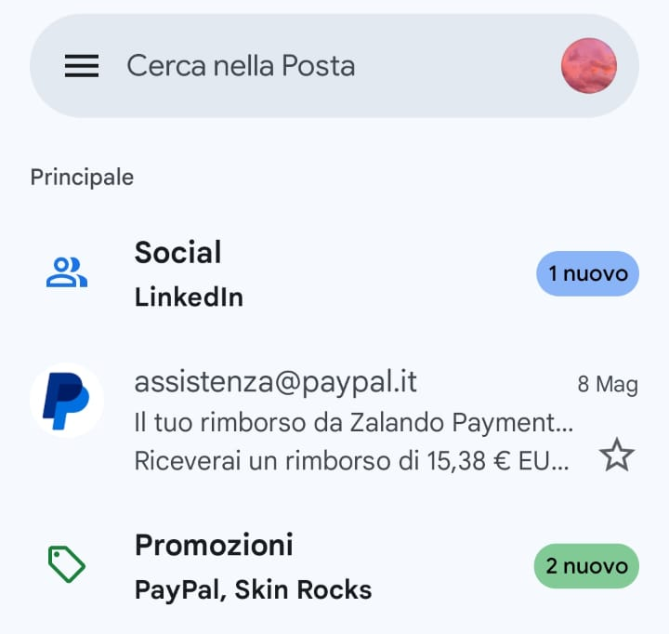
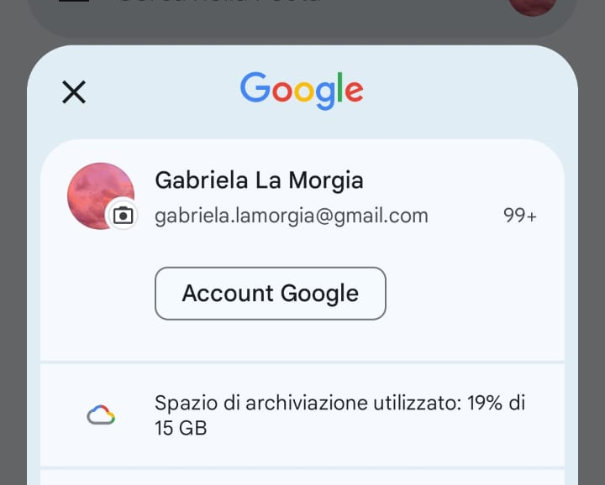
Where can I find my email?
Clicking on the box can open your mailbox.
By clicking on the icon above you can view your email address.
Now you know your address and you can give it to friends, family, family doctor so you can receive digital messages or digital documents from them.

Slide 5
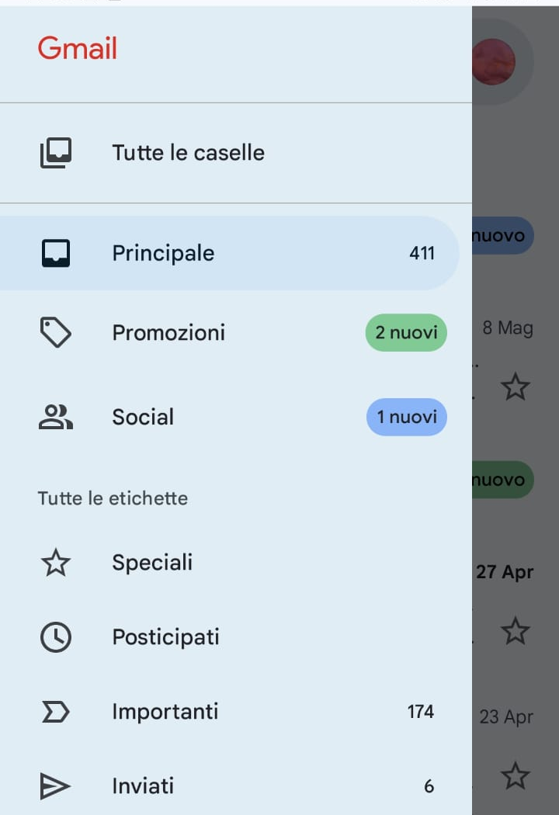
What's in my inbox?
The mailbox is like a piece of furniture with several drawers.
Each drawer contains one type of message.
Inbox (or Primary) – is the drawer where you receive messages. It is the one that you find already open when you open your mailbox
Sent Mail (or sent) – is the drawer where you find the messages you send to others

Slide 6
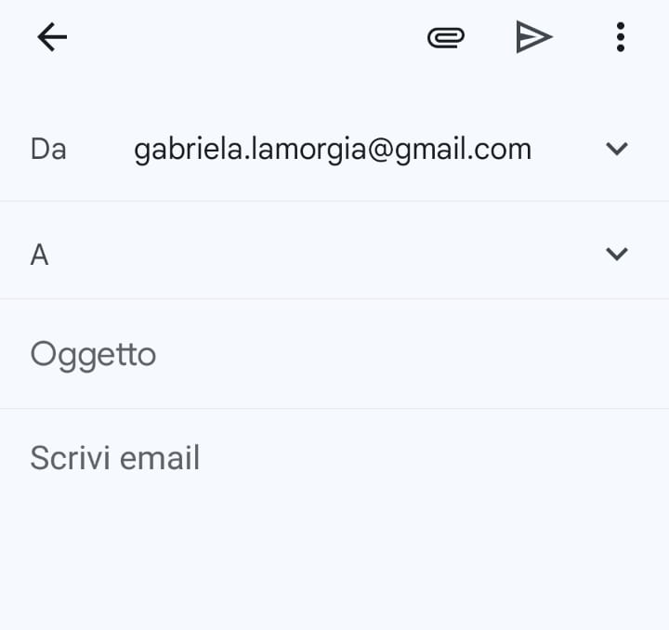
How to write an email?
Writing an email is like writing a letter.
Look for the "New Email" or "Write" button to open your digital spreadsheet.
Indicates who sends the message
Here you have to enter the email address of the person you want to send the message to
It is a short sentence that summarizes the content of your message.

Slide 7
How to write an email?
Once you have written your message click to send
Here you can add a document or photo you want to send
Write your message here

Slide 8
Beware of spam
Among the drawers available in your mailbox is the "spam" or "junk mail" box.
Unwanted messages such as advertisements, offers, scam messages arrive here.
Don't give your address to strangers
Don't click on links or open attachments from addresses you don't know.

Slide 9
